Slide 1

Multithreaded Chat Server
This presentation will explore the design and implementation of a multithreaded chat server, a system that allows multiple clients to communicate in real-time within different chat rooms. We'll delve into the key features, concepts, and benefits of multithreading in this context.
Team 18

Slide 2
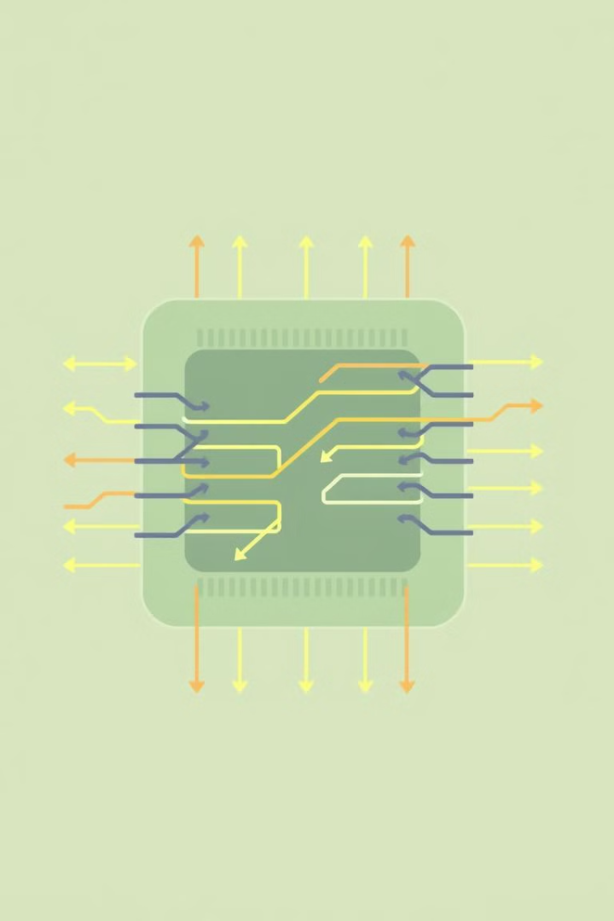
Multithreading
1
Concurrent Execution
2
Resource Optimization
Multithreading allows multiple threads, independent units of execution, to run concurrently within the same program.
Threads can share resources, such as memory and files, leading to better utilization and improved performance.
3
Enhanced Responsiveness
4
Increased Throughput
By dividing tasks among threads, programs can process more work simultaneously, boosting overall throughput.
Multithreading enables programs to respond more quickly to user inputs or events by offloading tasks to separate threads.

Slide 3




Main Server Thread Flow
Server Initialization
The main server thread creates a socket, binds it to a specified port, and listens for incoming client connections.
Client Connection Acceptance
When a client connects, the main thread accepts the connection and spawns a new thread dedicated to handling that specific client.
Client Thread Creation
The newly spawned thread is responsible for communication, message processing, and room management for the connected client.

Slide 4
How Client Threads Work
1
2
3
Client Message Handling
User Command Processing
Message Broadcasting
Each client thread continuously receives and processes incoming messages from its designated client based on the server's logic
Messages are interpreted as commands for actions like username changes, room management, and private messaging
Processed messages are distributed to other clients within the same chat room for real-time communication

Slide 5

Why Multithreading?
Efficiency
Each client operates independently without blocking others, leading to efficient resource utilization.
Scalability
The server can handle a large number of concurrent clients without compromising performance.
Non-Blocking Communication
Messages are processed in parallel, enabling real-time updates and a smooth user experience.

